Slide 1
Chapter 6
How to use CSS for page layout

Slide 2
Objectives
Applied
Given an HTML document, create a CSS style sheet that uses floating to implement a fixed or fluid page layout in two- or three-column format with both header and footer.
Knowledge
Describe the use of floating for page layout.
Describe the use of the clear property in a CSS rule set.
Distinguish between fixed and fluid page layout.
Describe the use of the CSS3 feature for text columns.
Describe the use of absolute, relative, and fixed positioning.

Slide 3
The HTML for a web page with a sidebar
<body>
<aside>
<p>The luncheon starts 15 minutes after the lecture ends</p>
</aside>
<main>
<p>Welcome to San Joaquin Valley Town Hall. We have some fascinating speakers for you this season!</p>
</main>
<footer>
<p>Please call today at (559) 555-1212 to get your tickets!</p>
</footer>
</body>

Slide 4
The CSS for floating the sidebar
body { width: 500px; }
main, aside, footer {
margin: 0;
padding: 0px 20px; }
aside {
margin: 0 20px 10px;
width: 150px;
float: right;
border: 1px solid black; }
footer { clear: both; }

Slide 5
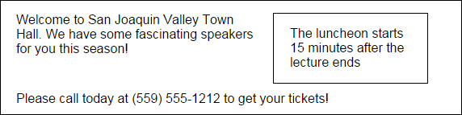
The web page with the side bar in a browser

Slide 6
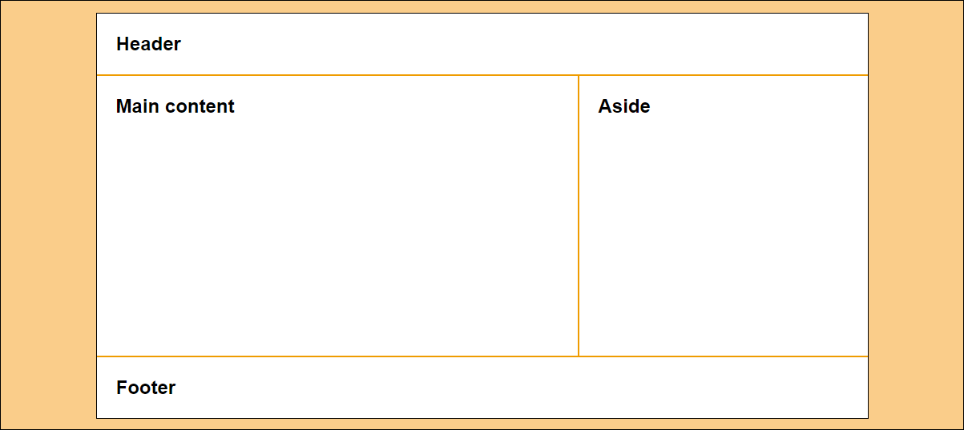
A 2-column web page with fixed-width columns

Slide 7
The HTML for the 2-column, fixed-width page
<body>
<header>
<h2>Header</h2>
</header>
<main>
<h2>Main content</h2>
</main>
<aside>
<h2>Aside</h2>
</aside>
<footer>
<h2>Footer</h2>
</footer>
</body>

Slide 8
The CSS for the 2-column, fixed-width page
* { margin: 0; padding: 0; }
body {
width: 962px;
background-color: white;
margin: 15px auto;
border: 1px solid black; }
h2 { padding: 1em; }
header { border-bottom: 2px solid #ef9c00; }
main {
height: 350px; /* to give the sidebar some height for its border */
width: 600px;
float: left;
border-right: 2px solid #ef9c00; }
aside {
width: 360px;
float: right; }
footer {
clear: both;
border-top: 2px solid #ef9c00; }

Slide 9
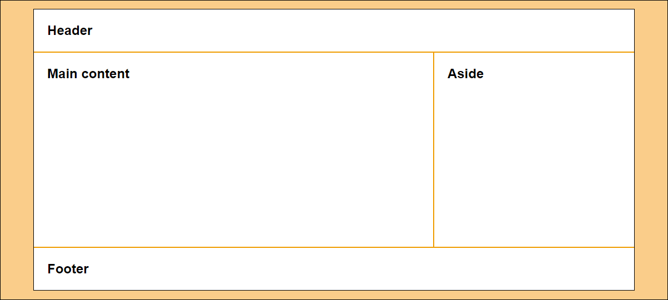
A 2-column page with fluid column widths

Slide 10
The CSS for the 2-column, fluid page
body {
width: 90%;
background-color: white;
margin: 15px auto;
border: 1px solid black; }
main {
width: 66%;
height: 350px; /* to give the main content some height */
border-right: 2px solid #ef9c00;
float: left; }
aside {
width: 33%;
float: right; }

Slide 11
The CSS when the aside is fixed and the section is fluid
body {
width: 90%;
background-color: white;
margin: 15px auto;
border: 1px solid black; }
main {
float: left; }
aside {
height: 350px; /* to give the aside some height */
width: 360px;
border-left: 2px solid #ef9c00;
float: right; }

Slide 12
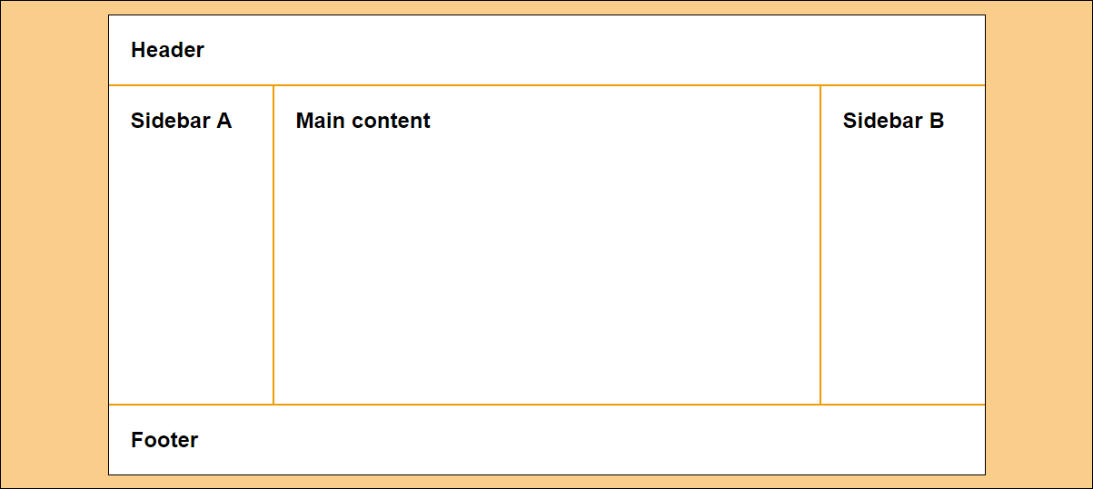
A 3-column page with fixed-width columns

Slide 13
The HTML for the 3-column page
<body>
<header>
<h2>Header</h2>
</header>
<aside id="sidebarA">
<h2>Sidebar A</h2>
</aside>
<main>
<h2>Main content</h2>
</main>
<aside id="sidebarB">
<h2>Sidebar B</h2>
</aside>
<footer>
<h2>Footer</h2>
</footer>
</body>

Slide 14
The CSS for the 3-column, fixed-width page
body {
width: 964px;
background-color: white;
margin: 15px auto;
border: 1px solid black; }
#sidebarA {
width: 180px;
height: 350px; /* to give the sidebar some height for its border */
float: left;
border-right: 2px solid #ef9c00; }
main {
width: 600px;
float: left; }
#sidebarB {
width: 180px;
height: 350px; /* to give the sidebar some height for its border */
float: right;
border-left: 2px solid #ef9c00; }

Slide 15
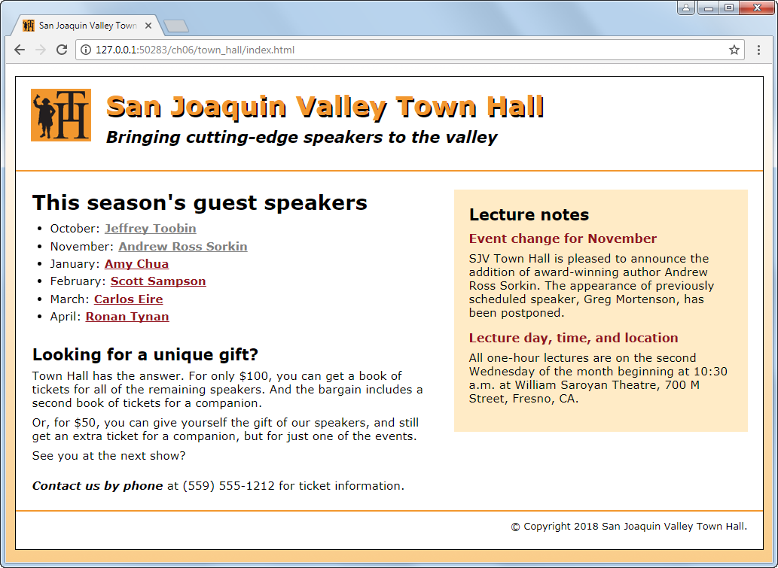
A home page with a sidebar floated to the right

Slide 16
The HTML for the home page (part 1)
<head>
.
<link rel="stylesheet" href="styles/normalize.css">
<link rel="stylesheet" href="styles/main.css">
</head>
<body>
<header>
<img src="images/logo.jpg" alt="Town Hall Logo" width="80">
<h2>San Joaquin Valley Town Hall</h2>
<h3>Bringing cutting-edge speakers to the valley</h3>
</header>
<main>
<aside>
<h2>Lecture notes</h2>
<h3>Event change for November</h3>

Slide 17
The HTML for the home page (part 2)
<p>SJV Town Hall is pleased to announce the addition of award-winning author Andrew Ross Sorkin. The appearance of previously
scheduled speaker, Greg Mortenson, has been postponed.</p>
<h3>Lecture day, time, and location</h3>
<p class="news_item">All one-hour lectures are on the second Wednesday of the month beginning at 10:30 a.m. at William
Saroyan Theatre, 700 M Street, Fresno, CA.</p>
</aside>

Slide 18
The HTML for the home page (part 3)
<section>
<h1>This season's guest speakers</h1>
<nav>
<ul>
<li>October: <a class="date_passed"
href="speakers/toobin.html">Jeffrey Toobin</a></li>
.
.
<li>March: <a href="speakers/eire.html">
Carlos Eire</a></li>
<li>April: <a href="speakers/tynan.html">
Ronan Tynan</a></li>
</ul>
</nav>
<h2>Looking for a unique gift?</h2>

Slide 19
The HTML for the home page (part 4)
<p>Town Hall has the answer. For only $100, you can get a book of tickets for all of the remaining speakers. And the bargain includes a second book of tickets for a companion.</p>
<p>Or, for $50, you can give yourself the gift of our speakers, and still get an extra ticket for a companion, but for just one
of the events.</p>
<p>See you at the next show?</p>
<p id="contact_us"><em>Contact us by phone</em> at (559) 555-1212 for ticket information.</p>
</section>
</main>
<footer>
<p>&copy; Copyright 2018 San Joaquin Valley Town Hall.</p>
</footer>
</body>
</html>

Slide 20
The CSS for the home page (part 1)
/* type selectors */
html {
background-image: -moz-linear-gradient( to bottom, white 0%, #facd8a 100%);
background-image: -webkit-linear-gradient(
to bottom, white 0%, #facd8a 100%);
background-image: -o-linear-gradient( to bottom, white 0%, #facd8a 100%);
background-image: linear-gradient( to bottom, white 0%, #facd8a 100%); }
body {
font-family: Verdana, Arial, Helvetica, sans-serif;
font-size: 100%;
width: 990px;
background-color: white;
margin: 15px auto;
padding: 15px 0;
border: 1px solid black; } /* no border radius or box shadow */

Slide 21
The CSS for the home page (part 2)
section, aside, h1, h2, h3, p {
margin: 0;
padding: 0; }
section, aside {
margin-top: 1.5em;
margin-bottom: 1em; }
a { font-weight: bold; }
a:link { color: #931420; }
a:visited { color: #f2972e; }
a:hover, a:focus { color: blue; }
ul {
margin-top: 0;
margin-bottom: 1.5em; }
li {
font-size: 95%;
padding-bottom: .35em; }
p {
font-size: 95%;
padding-bottom: .5em; }

Slide 22
The CSS for the home page (part 3)
em { font-weight: bold; }
/* the styles for the header */
header {
padding-bottom: 2em;
border-bottom: 2px solid #f2972e; }
header img {
float: left;
margin-left: 20px; }
header h2 {
font-size: 220%;
color: #f2972e;
text-shadow: 2px 3px 0 black;
margin-left: 120px;
margin-bottom:.25em; }
header h3 {
font-size: 130%;
font-style: italic;
margin-left: 120px; }

Slide 23
The CSS for the home page (part 4)
/* the styles for the section */
section {
width: 535px;
margin-left: 20px;
padding-right: 25px;
float: right; }
section h1 {
font-size: 170%;
margin-bottom: .35em; }
section h2 {
font-size: 130%;
margin-bottom: .35em; }
#contact_us { margin-top: 1em; }
a.date_passed { color: gray; }
/* the styles for the sidebar */

Slide 24
The CSS for the home page (part 5)
aside {
width: 350px;
float: right;
padding: 20px;
background-color: #ffebc6;
margin-right: 20px; }
aside h2 {
font-size: 130%;
padding-bottom: .5em; }
aside h3 {
font-size: 100%;
color: #931420;
padding-bottom: .5em; }
aside p { margin-bottom: .5em; }
/* the styles for the footer */
footer {
clear: both;
border-top: 2px solid #f2972e;
padding-top: .7em; }

Slide 25
The CSS for the home page (part 6)
footer p {
font-size: 80%;
text-align: right;
margin-right: 20px; }

Slide 26
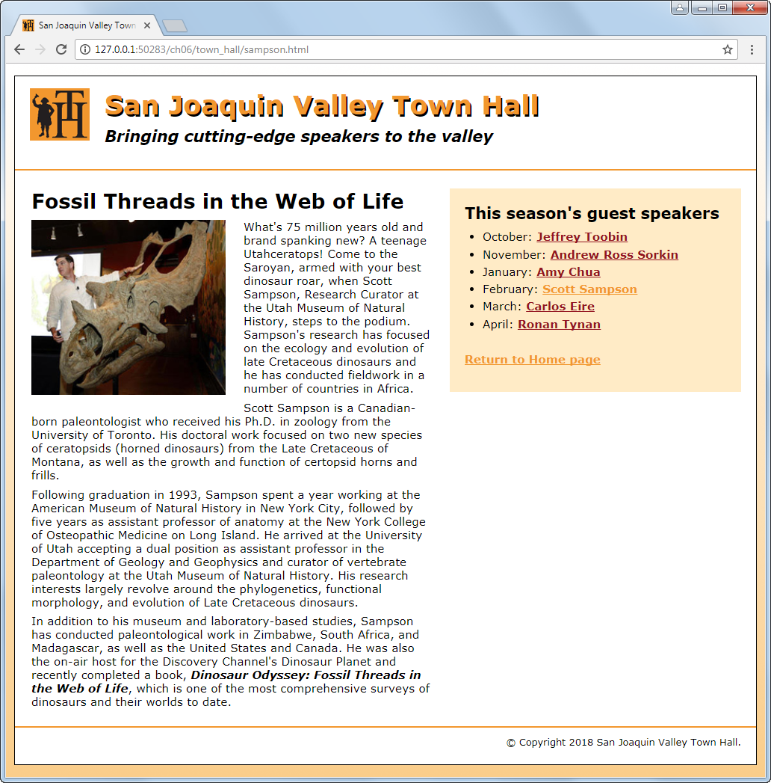
A speaker page with a sidebar on the right

Slide 27
The HTML for the speaker page (part 1)
<head>
...
<link rel="stylesheet" href="styles/speaker.css">
</head>
<aside>
<h2>This season's guest speakers</h2>
<nav>
<ul>
<li>October: <a class="date_passed"
href="speakers/toobin.html">Jeffrey Toobin</a></li>
.
.
<li>April: <a href="speakers/tynan.html">Ronan Tynan</a></li>
</ul>
<p><a href="index.html">Return to Home page</a></p>
</nav>
</aside>

Slide 28
The HTML for the speaker page (part 2)
<article>
<h1>Fossil Threads in the Web of Life</h1>
<img src="images/sampson_dinosaur.jpg" alt="Scott Sampson" width="260">
<p>What's 75 million years old and brand spanking new? A teenage
...
...</p>
<p>Scott Sampson is a Canadian-born paleontologist who received his
...
...</p>
<p>Following graduation in 1993, Sampson spent a year working at the
...
...</p>
<p>In addition to his museum and laboratory-based studies, Sampson has
...
...</p>
</article>

Slide 29
The CSS for the speaker page
article, aside, h1, h2, p, ul {
margin: 0;
padding: 0; }
article, aside {
margin-top: 1.5em;
margin-bottom: 1em; }
/* the styles for the article */
article {
width: 535px;
margin-left: 20px;
padding-right: 25px;
float: right; }
article h1 {
font-size: 170%;
margin-bottom: .35em; }
article img {
float: left;
margin: 0 1.5em 1em 0; }

Slide 30
The primary CSS3 properties for creating text columns
column-count
column-gap
column-rule
column-span
3 columns with default-sized gaps
article {
column-count: 3; }
3 columns with 35px gaps and 2px rules between the columns
article {
column-count: 3;
column-column-gap: 35px;
column-rule: 2px solid black; }

Slide 31
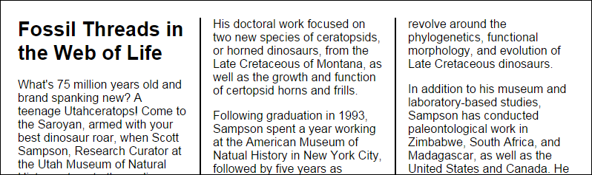
3 columns with 35px gaps and 2px rules in a browser window

Slide 32
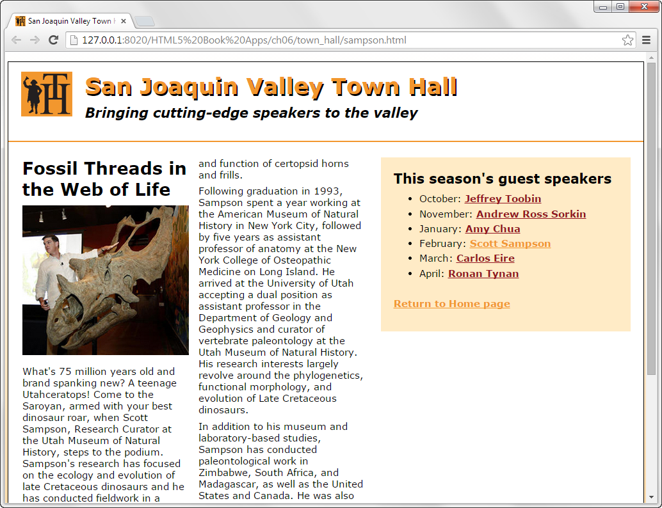
A web page with a two-column article

Slide 33
The CSS for creating the columns
article {
column-count: 2;
}

Slide 34
Properties for positioning elements
position
top, bottom, left, right
z-index
Possible values for the position property
static
absolute
fixed
relative

Slide 35
The HTML for a web page that will use positioning
<body>
<main>
<h1>Our speakers this season</h1>
<ul>
<li>October: <a href="speakers/toobin.html">
Jeffrey Toobin</a></li>
<li>November: <a href="speakers/sorkin.html">
Andrew Ross Sorkin</a></li>
<li>January: <a href="speakers/chua.html">
Amy Chua</a></li>
</ul>
<p>Please contact us for tickets.</p>
</main>
<aside>
<p><a href="raffle.html">Enter to win a free ticket!</a></p>
</aside>
</body>

Slide 36
The CSS for the web page with absolute positioning
p { margin: 0;}
body {
width: 550px;
margin: 0 25px 20px;
border: 1px solid black;
position: relative; } /* not needed for fixed positioning */
aside {
width: 80px;
padding: 1em;
border: 1px solid black;
position: absolute; /* change to fixed for fixed positioning */
right: 30px;
top: 50px; }

Slide 37
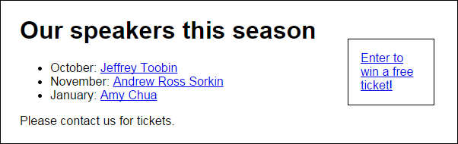
The web page with absolute positioning in a browser

Slide 38
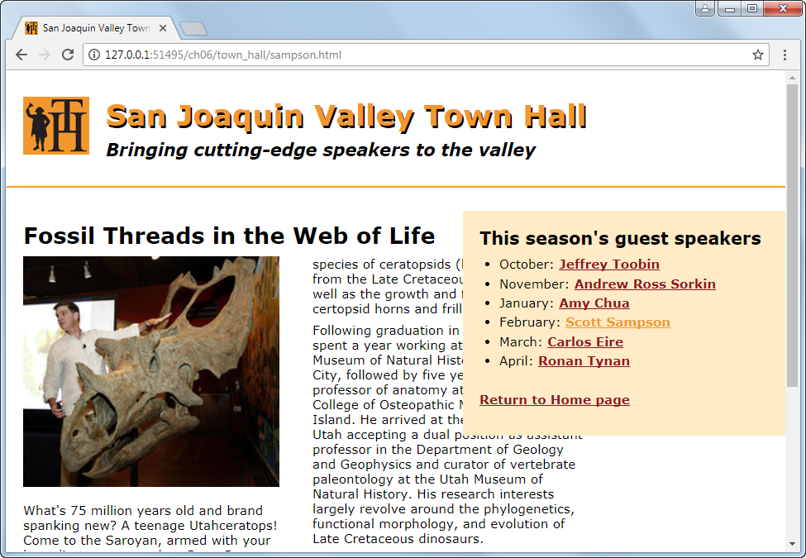
A sidebar that uses fixed positioning

Slide 39
The CSS for the positioned element
aside {
width: 350px;
padding: 20px;
background-color: #ffebc6;
position: fixed;
right: 0;
top: 170px;
}

Slide 40
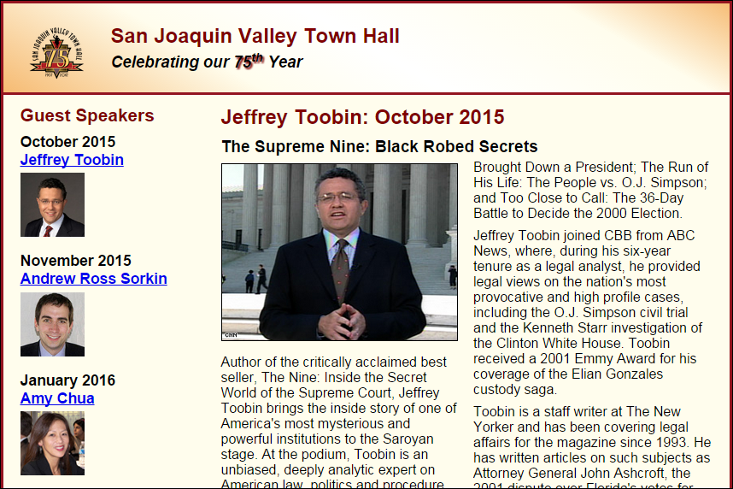
Short 6-1 Use the CSS3 columns feature

Slide 41
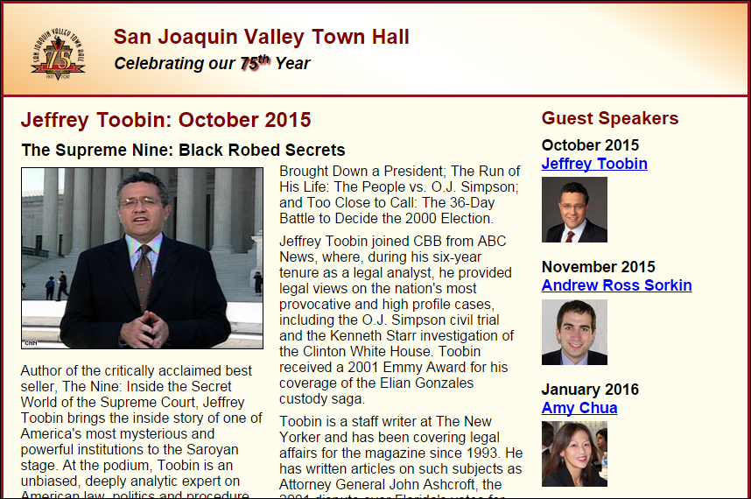
Short 6-2 Switch the columns of a page

Slide 42
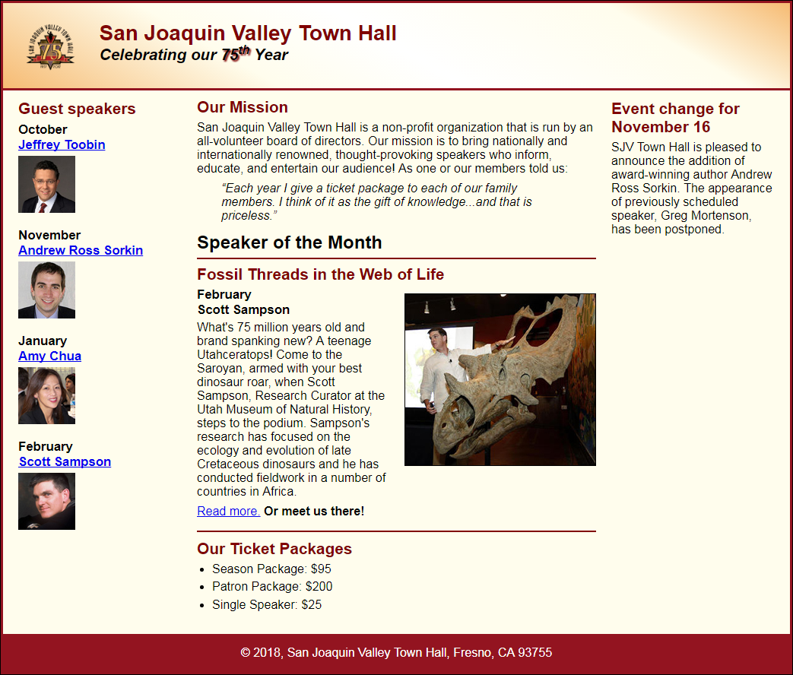
Short 6-3 Add a third column to a page

